Slide 1
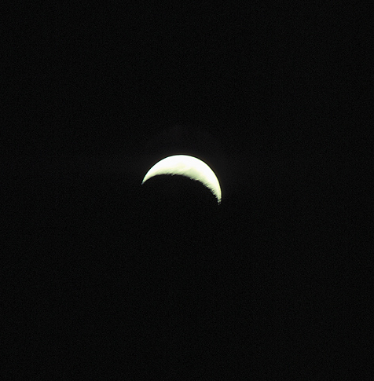
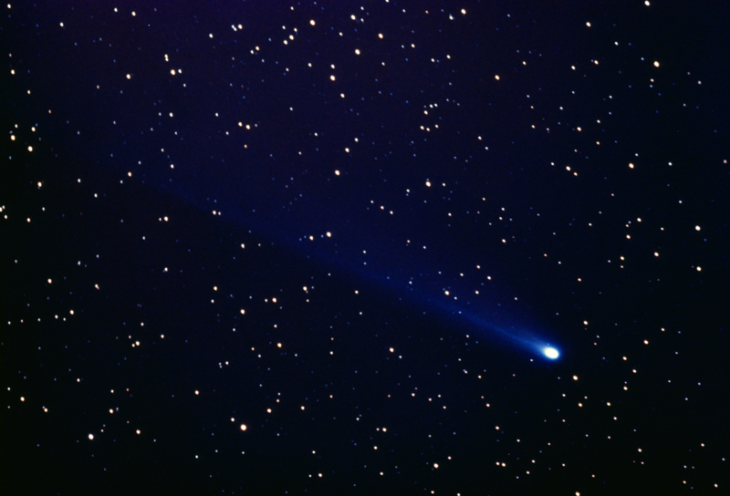
Images: © 2017 www.clipart.com. Used by permission.

Slide 2
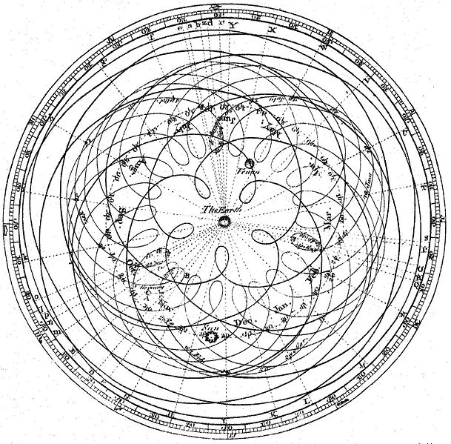
Image in public domain. Available at: https://commons.wikimedia.org/wiki/File:Cassini_apparent.jpg

Slide 3
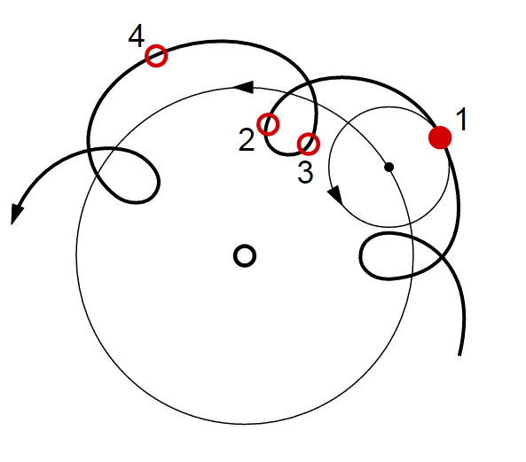
Image in public domain. Available at: https://commons.wikimedia.org/wiki/File%3AEpicycle_and_deferent.svg

Slide 4
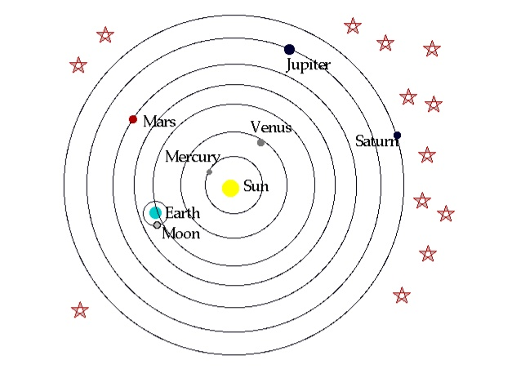
Image in public domain. Available at: www.conservapedia.com/File:Copernicus_system.gif

